Slide 1
Language models
Natural Language Processing
Fall 2020
New York University

Slide 2
Probabilistic language models
A language model defines a probability distribution over all possible sequences of words
$$P(s)=P(w_{1}w_{2}…w_{n_{s}})$$
$$\underset{s}{∑}P(s)=1$$
(Not any model used in language technologies)

Slide 3

Why is this useful: speech recognition
how to recognize speech or how to wreck a nice beach?
I saw a van, or eyes awe of an?

Slide 4
Classic applications of language models: machine translation
Word-by-word translation of French “grands vents” to English:
“high winds” or “large winds”
P(high winds) > P(large winds)

Slide 5
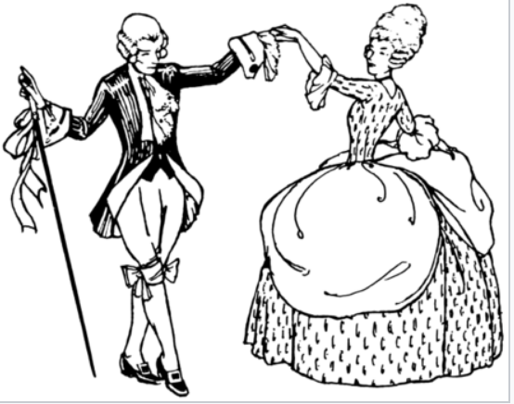
Classic applications of language models: spell checking
The office is about fifteen minuets from my house
P(about fifteen minutes from)
P(about fifteen minuets from)

Slide 6
Bayes’ law
Posterior
Likelihood
Prior
$$P(C|D)=\frac{P(D|C)P(C)}{P(D)}$$
“Evidence” / normalizing factor

Slide 7
Bayes’ law for automatic speech recognition
Language model
“recognize speech”
$$P(w)$$
$$arg\max_{w∈L}P(w|s)$$
Acoustic model
$$P(s|w)$$
s : (features of) the acoustic signal
w : a word
L : the lexicon (set of all words)

Slide 8
Probabilistic language models
How do we compute the probability of the sequence its water is so transparent that?
P(its, water, is, so, transparent, that)
Chain rule of probability: $P(A,B)=P(A)P(B|A)$
Applied again: $P(A,B,C)=P(A)P(B|A)P(C|A,B)$
Decompose P(its, water, is, so, transparent, that)

Slide 9
Probabilistic language models
We’re estimating P(its, water, is, so, transparent, that)
How can we estimate P(water | its) from a corpus?
What about P(is | its, water)?
And P(that | its, water, is, so, transparent)?
What kind of simplifying assumption can we make?

Slide 10
The Markov assumption
Assume that P(that | its, water, is, so, transparent) ≈ P(that | transparent): a bigram model
Or P(that | its, water, is, so, transparent) ≈ P(that | so, transparent): a trigram model
An n-gram model conditions only on the last n-1 words
Is this in general a reasonable assumption about language?
No: The key that I left on the table by the armchairs is
But it can be effective in many cases!

Slide 11
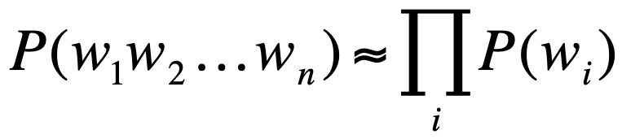
n-gram models
Unigram:
Bigram:
An n-gram model conditions on the last n-1 words!

Slide 12
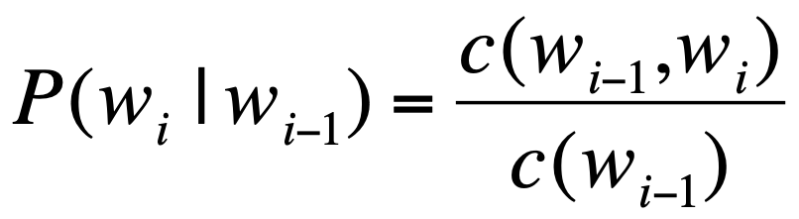
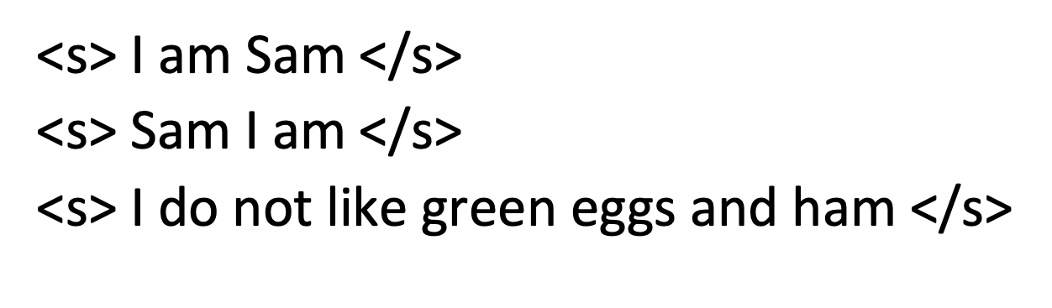
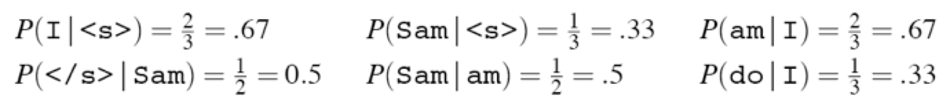
Estimating the probabilities
Maximum likelihood estimate:
If this is our corpus:

Slide 13
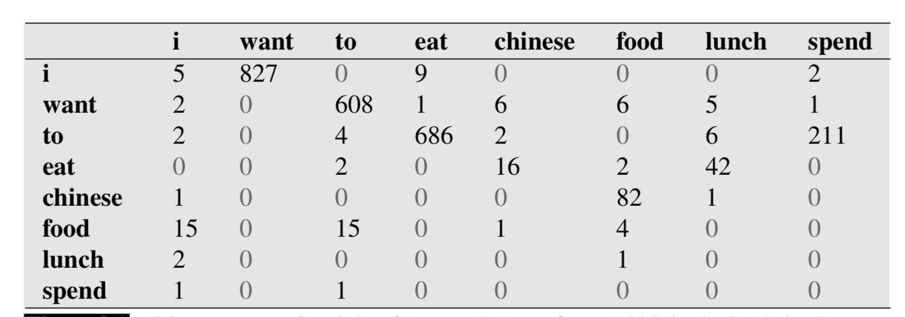
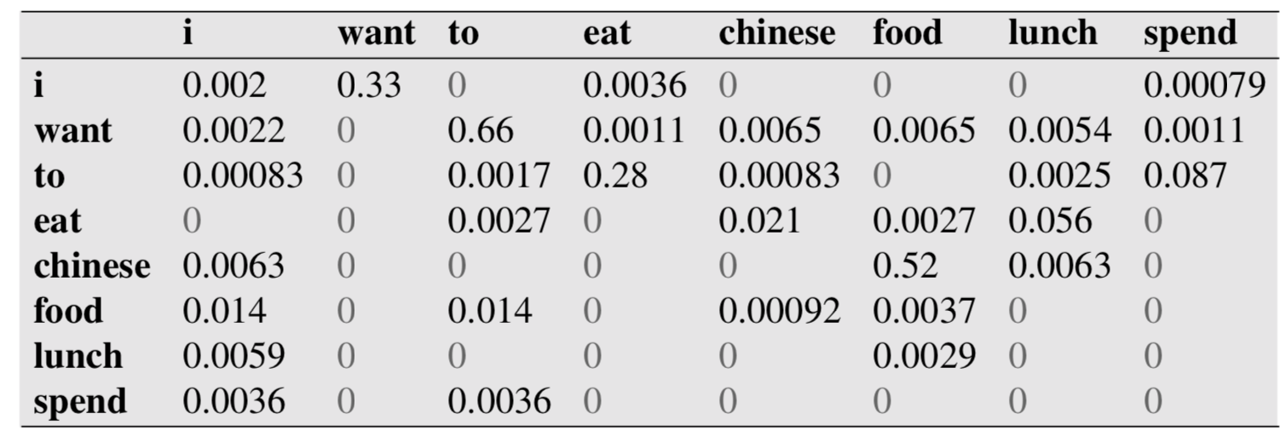
The Berkeley restaurant corpus

Slide 14
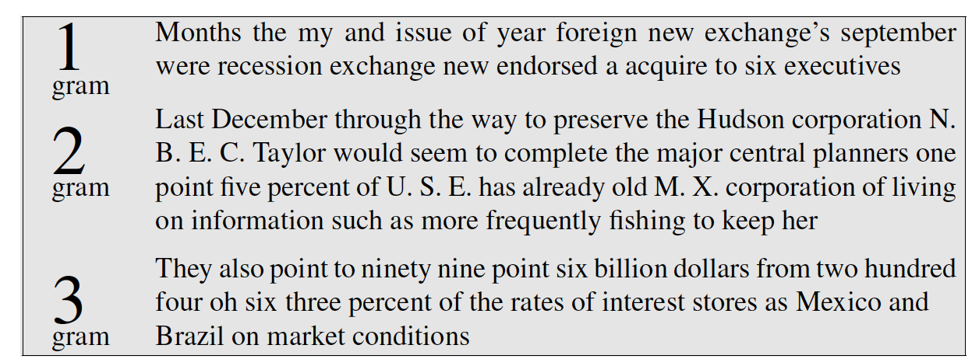
Language model evaluation: samples
Bigrams:
(Trained on the Wall Street Journal corpus)

Slide 15
Language model evaluation
How do we quantitatively evaluate how good our language model is?
We want our model to assign high probability to “reasonable”, “frequent”, “well-formed” or “grammatical” sentences
These adjectives are to some extent in conflict with each other

Slide 16
Language model evaluation
Classic intrinsic LM evaluation:
Divide the corpus into a training set and a test set
A good LM is one that assigns a high likelihood to the sentences in the test set

Slide 17
Language model evaluation
Q1: Why not just measure the probability assigned by the LM to the training set?
Q2: What are potential disadvantages of intrinsic evaluation?
Extrinsic evaluation: does my new LM reduce word error rate in automatic speech recognition over the old LM?
Q3: Can we expect an LM to assign a high probability to all grammatical sentences?

Slide 18
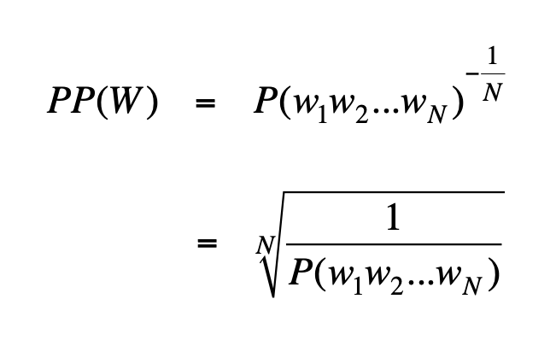
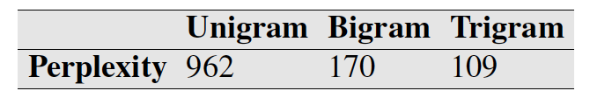
Perplexity
Inverse probability assigned to the test set, normalized by the number of words:
$$logPP(W)=-\frac{logP(w_{1}w_{2}…w_{N})}{N}$$
On the WSJ:

Slide 19
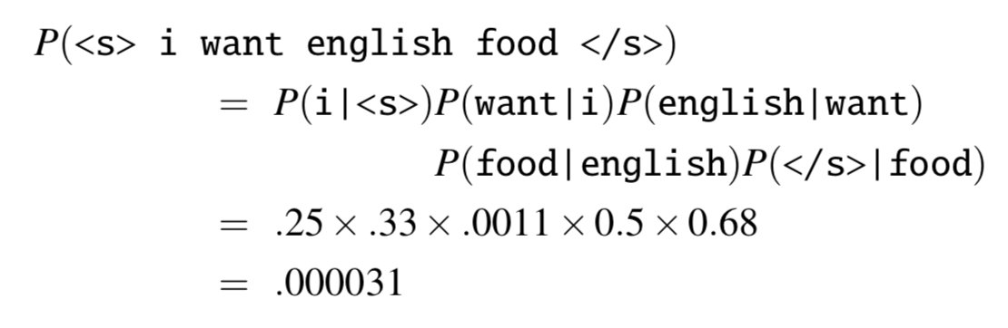
Technical comment 1: log probabilities
$$P(w_{1},…,w_{n})=P(w_{1})×P(w_{2}|w_{1})×P(w_{3}|w_{2})×…×P(w_{n}|w_{n-1})$$
The result can get very small and cause underflow! Better:
$$logP(w_{1},…,w_{n})=logP(w_{1})+logP(w_{2}|w_{1})+…+logP(w_{n}|w_{n-1})$$

Slide 20
Technical comment 2: Unknown words
What happens if the test set has a word the LM did not encounter in training?
One option: replace all low-frequency words (e.g., all but the top 50000 words in the training sets) with a special <UNK> token
P(<UNK> | context): what is the probability of seeing a new word in this context?
Another option: falling back on a character-based model

Slide 21
Generalization in language models based on maximum likelihood estimates
If this is our corpus:
What is P(I do not like green eggs </s>)?
Bigrams that were not observed in the training set are assumed to be impossible!

Slide 22
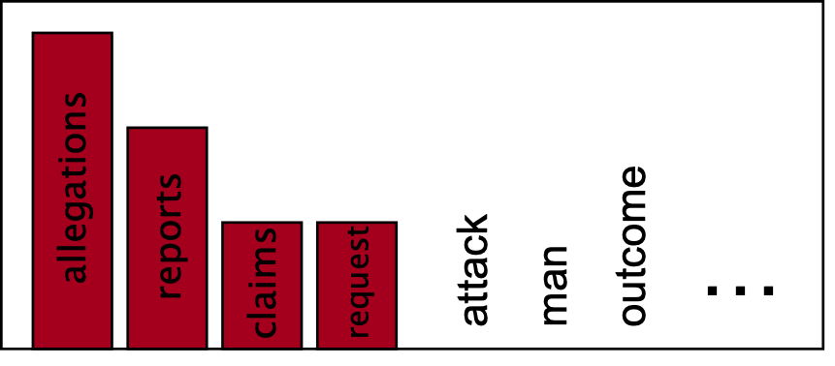
Improving generalization
What is the perplexity of the test set if it includes the trigram denied the attack?
Maximum likelihood estimates overfit to the training data
P(w | denied the)

Slide 23
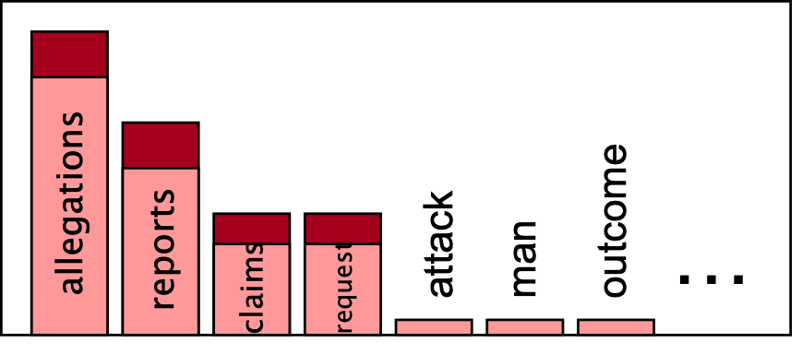
Smoothing: improving generalization
P(w | denied the)
Maximum likelihood estimate:
Smoothed estimate:

Slide 24
Maximum likelihood estimate

Slide 25
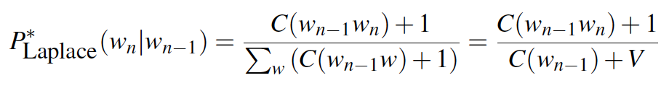
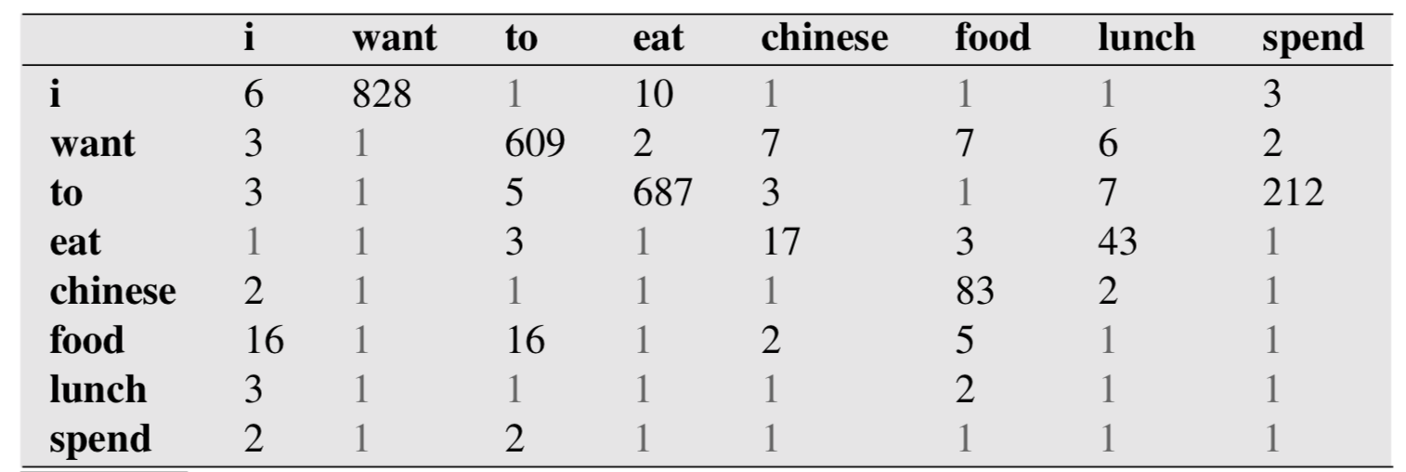
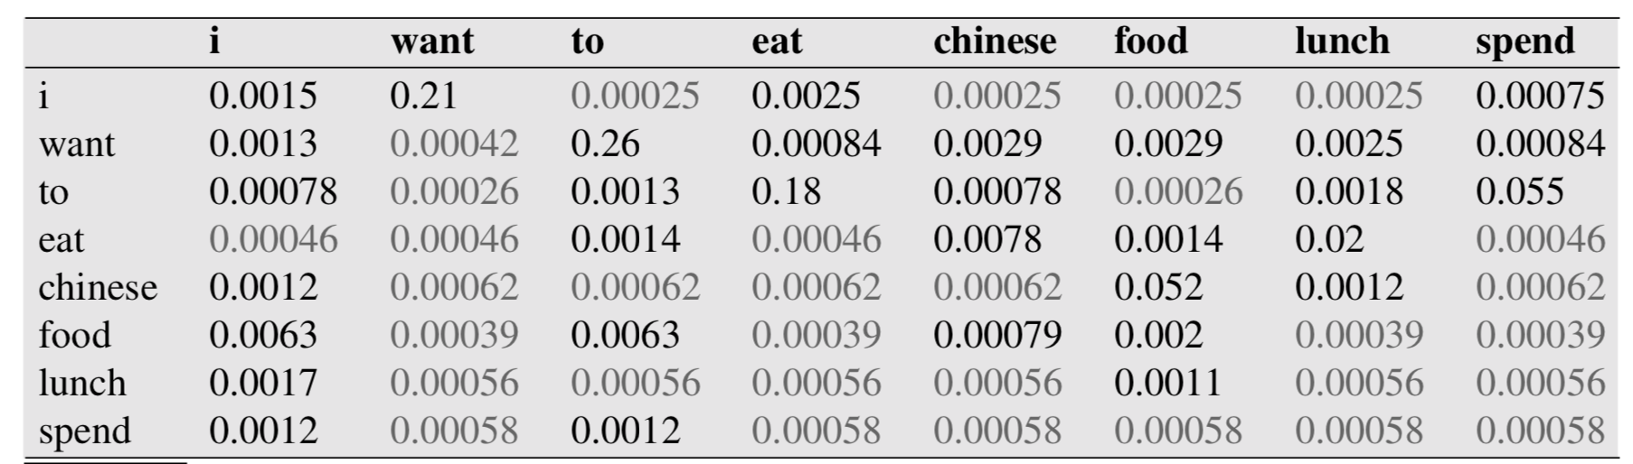
Add-1 smoothing
V=1446

Slide 26
Did we smooth too much?
MLE:
V=1446: a lot of rows in each column!
Add-1:

Slide 27
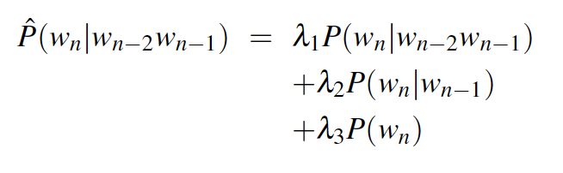
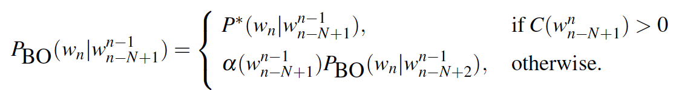
Backoff and interpolation
Counts with larger context (e.g., trigrams) are sparser than counts with less context (e.g., bigrams)
Interpolation: always use some mix of trigram, bigram and unigram:
Backoff: if the trigram count is zero, use the bigram count instead + discount attested n-grams

